Slide 1

Federated Learning: Gradient Conflict Mitigate
Presented by Trong-Binh Nguyen-202388548 Pusan National University
December 15th, 2023

Slide 2
Table of contents
Federated Learning
Introduction
Basic structure
Challenges
Approach: Gradient Conflict Mitigate
State of the art
Proposal
Simulation
Simulation

Slide 3
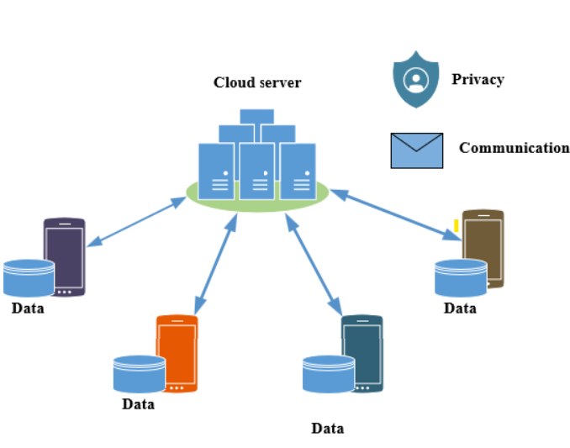
1. Federated Learning: Introduction
Technology advance:
Advantages:
Data explosion
Deep insights into data distribution
Disadvantages:
Privacy of users
Communication overhead
Federated Learning
Decentralized Learning technique
Provides privacy
Good performance

Slide 4
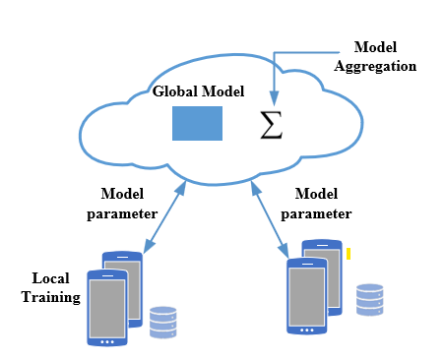
1. Federated Learning: Basic structure
Server:
Global model initialization
Receive client model parameters update
Performing optimization based on parameters
Sending back parameters to clients
Clients:
Training based on the local client dataset
Sending model update to the server
Model Architecture:
Server and client share the same model architecture but different parameters
Design model suitable for the tasks
Note:
Only parameters communicated

Slide 5
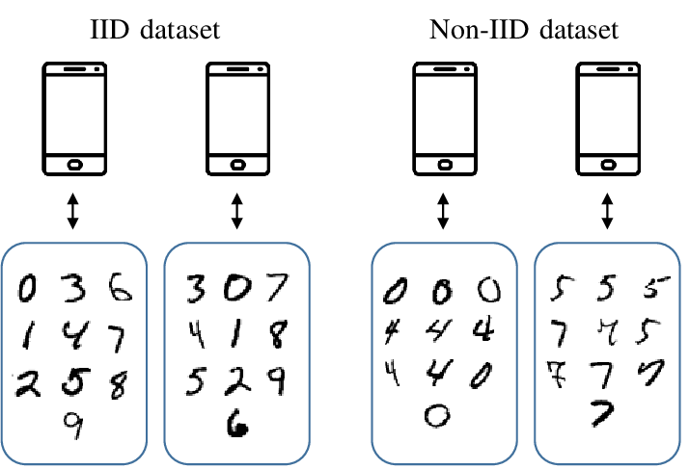
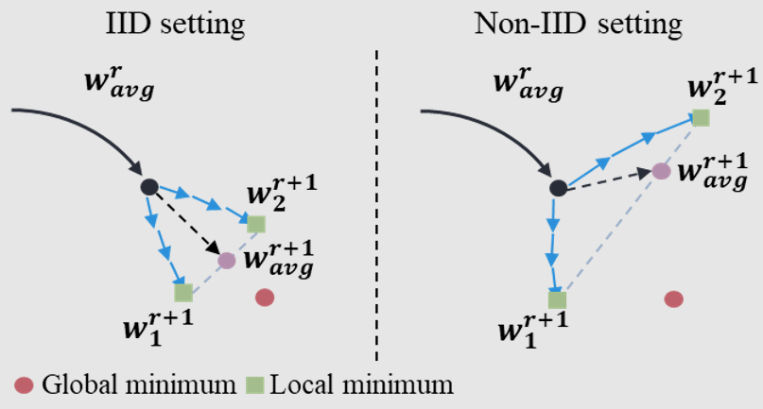
1. Federated Learning: Challenges
Heterogeneity - non IID:
Devices in a federated learning system may have different types of data
Data from different sources, leading to variations in data distributions.

Slide 6
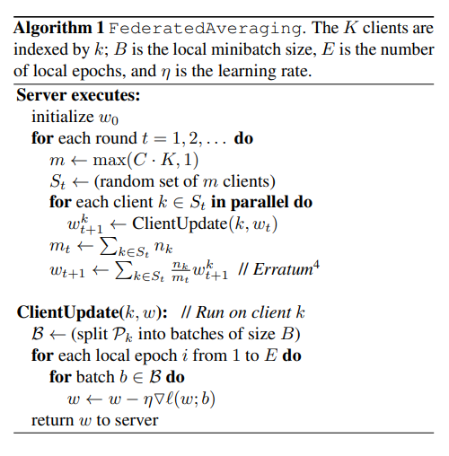


1. Federated Learning: Basic Algorithm
Training on the local clients using gradient descent.
Perform the simple aggregation step as averaging in FedAvg
H. B. McMahan, E. Moore, D. Ramage, S. Hampson, and B. A. y Arcas, “Communication-efficient learning of deep networks from decentralized data,” 2016 Google Research paper

Slide 7
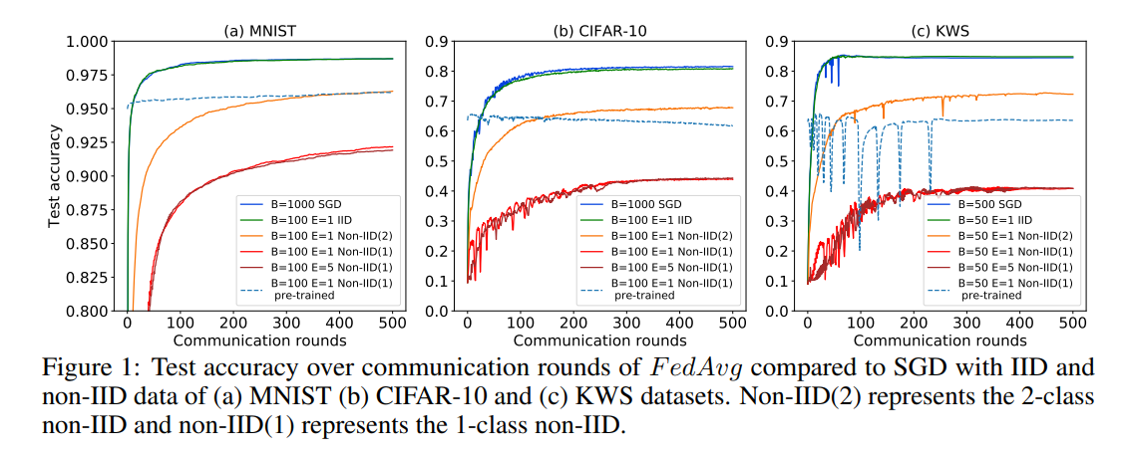
1. Federated Learning: Challenges
Zhao, Yue, et al. "Federated learning with non-iid data." arXiv preprint arXiv:1806.00582 (2018).

Slide 8
2. Approach: State of the art
Local Optimization:
Personalized Federated Learning
Personalized step according to different client domain [1,2,3]
Problem with current approach:
Gradient conflict
Model averaging is not optimal
[1] Fallah, A., Mokhtari, A., and Ozdaglar, A. Personalized federated learning: A meta-learning approach
Advances in Neural Information Processing Systems, 2020
[2] T Dinh, C., Tran, N., and Nguyen, J. Personalized federated learning with moreau envelopes.
Advances in Neural Information Processing Systems, 2020 [3] Nguyen, A. T., Torr, P., and Lim, S. N. Fedsr: A simple and effective domain generalization method for federated learning.
Advances in Neural Information Processing Systems, 2022.

Slide 9


2. Approach: Gradient Perspective
Gradient Perspective of Federated Learning:
Server:
Perform Averaging
Clients:
SGD on local dataset to get new model parameter
Sending parameter to the server
Server:
Averaging Gradient parameter
Perform Server Update
Clients:
SGD on local dataset to get new model parameter
Gradient parameter = new model parameter – global parameter
Sending gradient parameter to the server

Slide 10
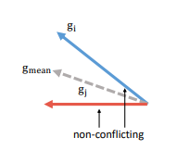
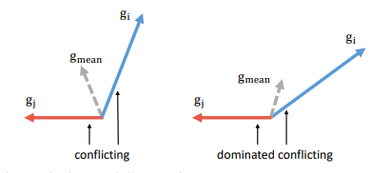
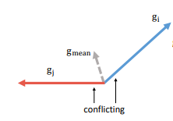
2. Approach: Gradient Conflict

Slide 11





2. Approach: Proposal
Yu, T., Kumar, S., Gupta, A., Levine, S., Hausman, K., and Finn, C. Gradient surgery for multi-task learning.
Advances in Neural Information Processing Systems, 2020.
Liu, B., Liu, X., Jin, X., Stone, P., and Liu, Q. Conflict-averse gradient descent for multi-task learning.
Advances in Neural Information Processing Systems, 2021
Sener, O. and Koltun, V. Multi-task learning as multi-objective optimization.
Advances in neural information processing systems, 2018
For simplicity: Denote and global parameter and global update
: global step size and update vector
The optimization problem is:
Where is hyper-parameter and is the average gradient
Gradient of task i

Slide 12
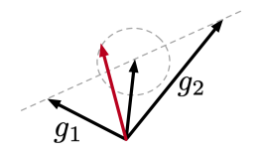
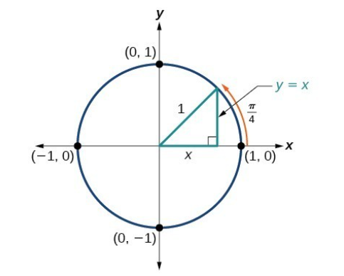
2. Approach: Proposal
Dominate vector :
Angle between the average gradient and dominate vector is small
Angle between the average gradient and the anther vector is large
Dot product to calculate the cos between vectors
Proposal: Finding the best vector update in the neighbor of average gradient that maximize the most divergent local gradient

Slide 13
2. Approach: Proposal
Dominate vector :
Angle between the average gradient and dominate vector is small
Angle between the average gradient and the anther vector is large
Dot product to calculate the cos between vectors
Proposal: Finding the best vector update in the neighbor of average gradient that maximize the most divergent local gradient

Slide 14
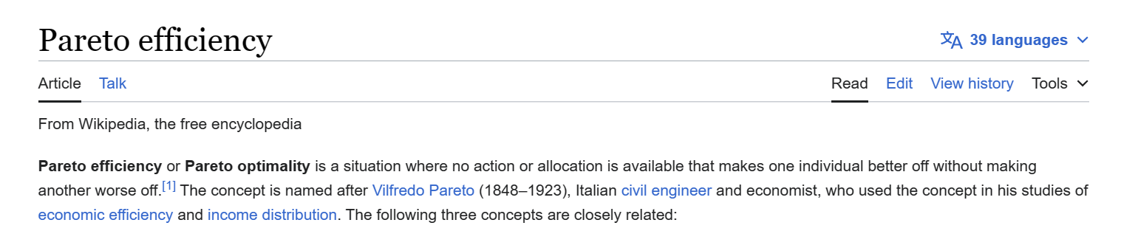
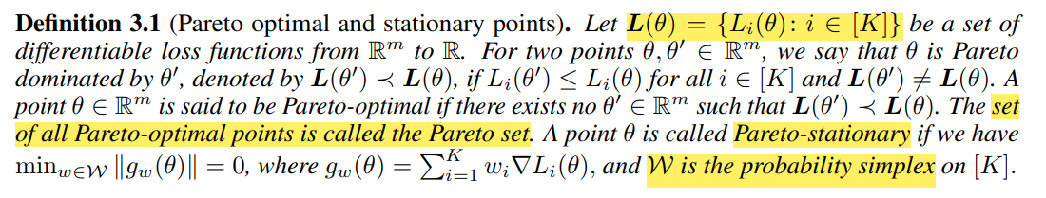
2. Approach: Proposal
Pareto optimality for multi-objective optimization

Slide 15

2. Approach: Proposal
W is the probability simplex
Probability simplex of K users:
For example K =2 we have 1 set {0.2, 0.8}
K =3 we have 1 set {0,1, 0.1, 0.8}
Average gradient also included in the probability set.
Proved this with gw = g0

Slide 16
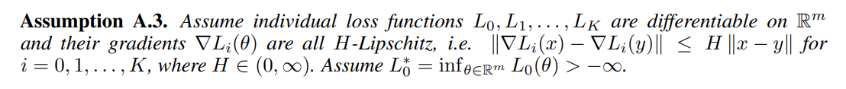

2. Approach: Summary
T increase to L0 is bound
We have the our approach goes close to the pareto stationary => Proven

Slide 17
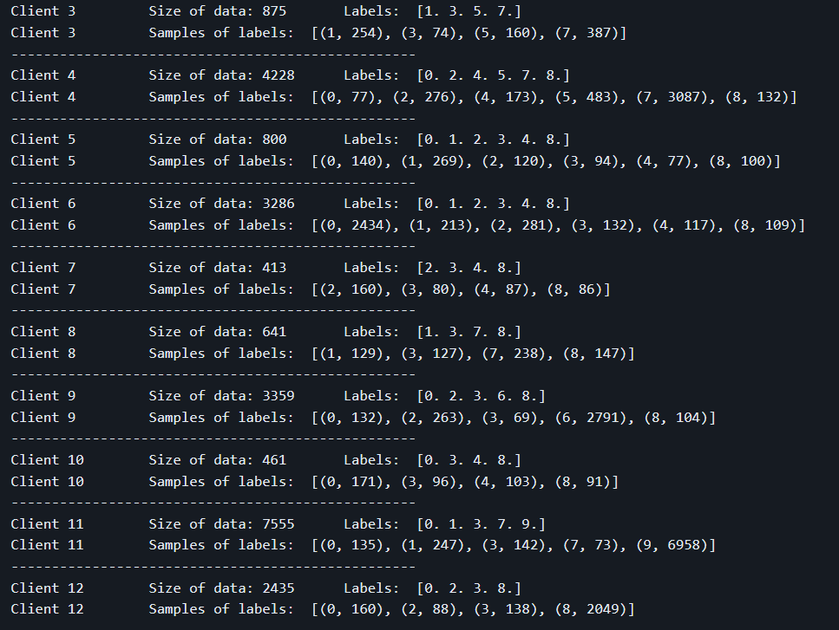
3. Simulation: Simulation
200 global rounds, 50 clients, dataset non IID with Dirichlet distribution
https://github.com/TsingZ0/PFLlib.git

Slide 18
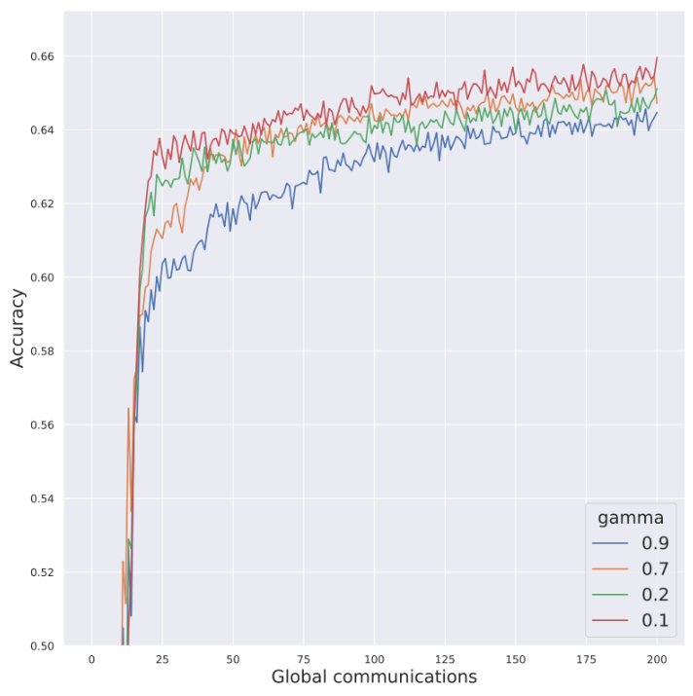
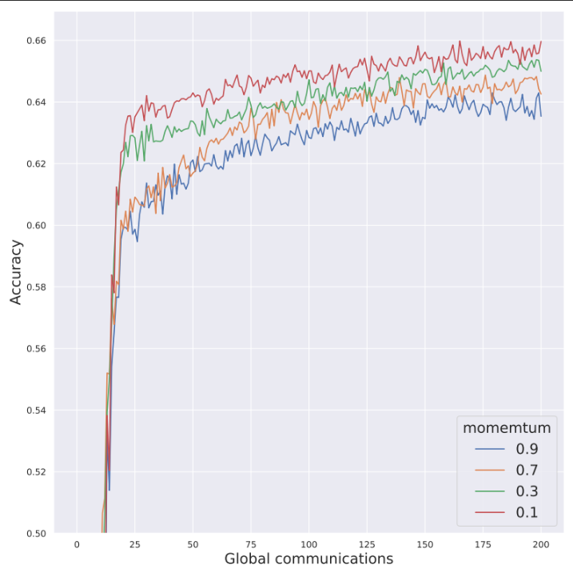
3. Simulation: Simulation

Slide 19
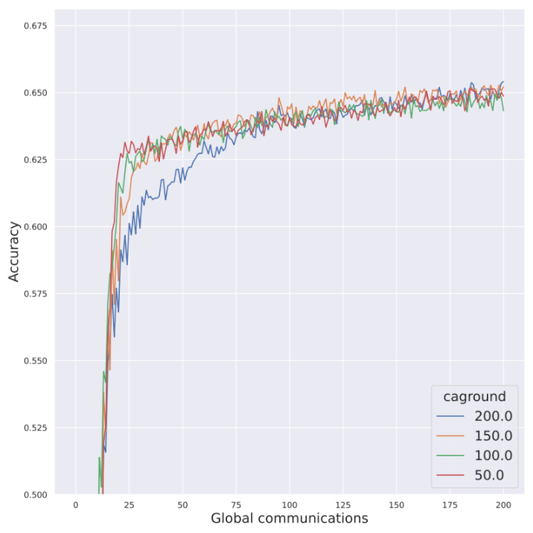
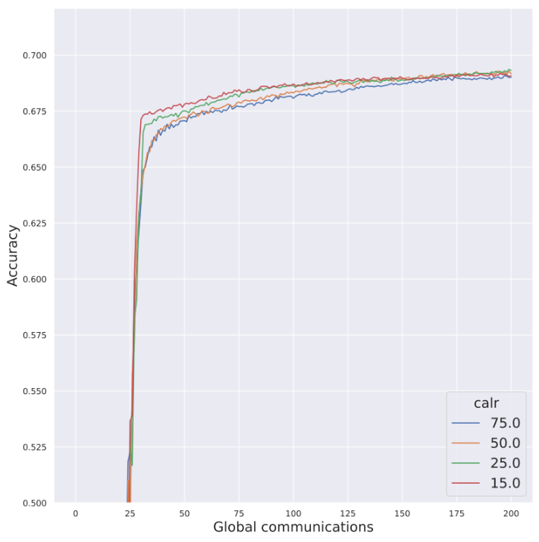
3. Simulation: Simulation

Slide 20
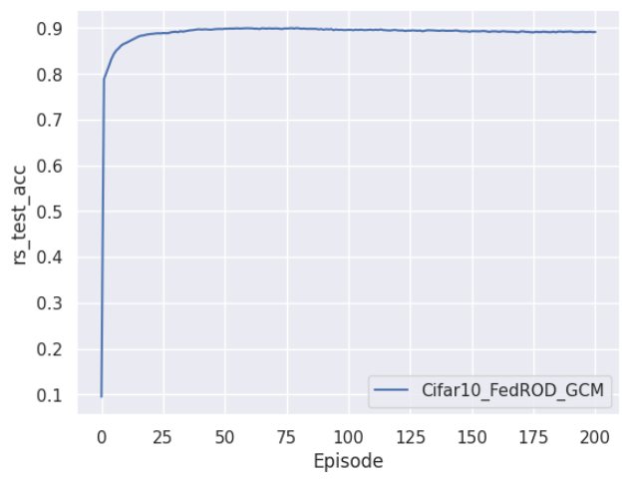
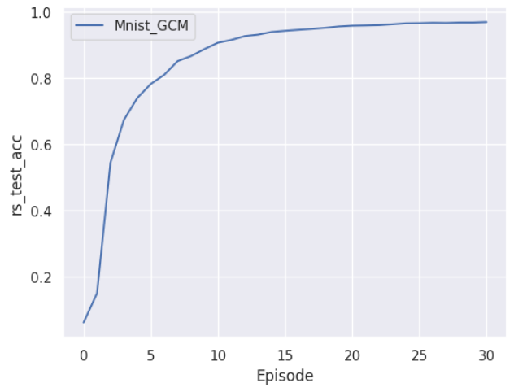
3. Simulation: Simulation
Chen, Hong-You, and Wei-Lun Chao. "On bridging generic and personalized federated learning for image classification." International conference on Learning Representation 2022, (ICLR 2022)

Slide 21
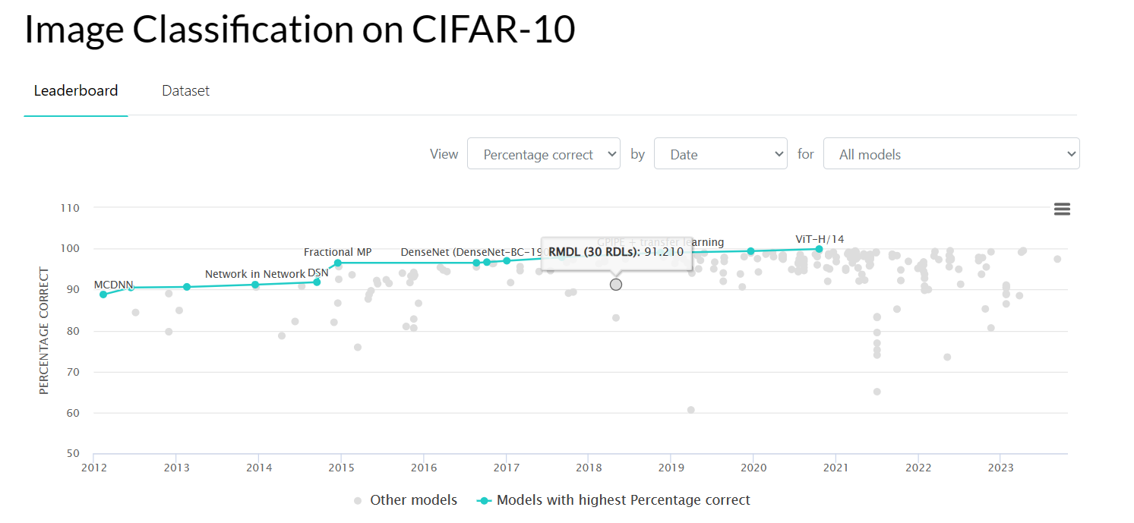
3. Simulation: Simulation

Slide 22
QUESTION TIME

